Slide 1

NLP Chatbot Development Using Dialogflow
Group Id: F24PROJECTB3B8C
Name

Slide 2

Project Title & Introduction
HR.Restaurant – AI Chatbot for Restaurant Management By: Hafsa Student ID: BC210414048 Course: CS619 – Final Year Project (Fall 2024) Supervisor: Abdullah Qamar

Slide 3
Project Objectives
Main Aim: Automate table booking, menu browsing, ordering, support using NLP + Web tech.
Tech Stack: Dialogflow, Flask, HTML/CSS/JS, MySQL
Impact: Smart, fast, and seamless restaurant experience.

Slide 4

The Restaurant Chatbot automates customer interactions by handling reservations, menu navigation, order placement, and support, ensuring quick service and better user experience
Purpose:

Slide 5
Make Reservations – Book, modify, or cancel tables.
Menu Navigation – Explore menu items and categories.
Place Order – Order food and modify selections.
Customer Support – Live chat, FAQs, order tracking, and feedback.
Features:

Slide 6
Introduction Of the Project
My project is an NLP-based Restaurent chatbot designed to automate customer interactions using Natural Language Processing (NLP). It enables users to make reservations, explore menus, place orders, and get support through an intelligent conversational interface. Built with Dialogflow, Python (Flask), and MySQL, this chatbot enhances user experience by providing quick and accurate responses on a web-based platform.

Slide 7
NLP & Dialogflow Basics
NLP enables computers to understand natural language.
Dialogflow provides:
- Intents (user goals)
- Entities (data extraction)
- Contexts (conversation flow)
- Fulfillment (backend logic)
Analogy: A smart, responsive waiter.

Slide 8
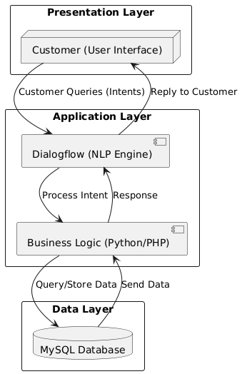
Technologies Used
Natural Language Processing (NLP): Dialogflow (for chatbot intelligence)
Backend: Python (Flask for API and database management)
Database: MySQL (for storing orders, reservations, and user data)
Frontend: HTML, CSS, JavaScript (for the web-based interface)
Integration: Webhooks (to connect chatbot with backend and database)

Slide 9
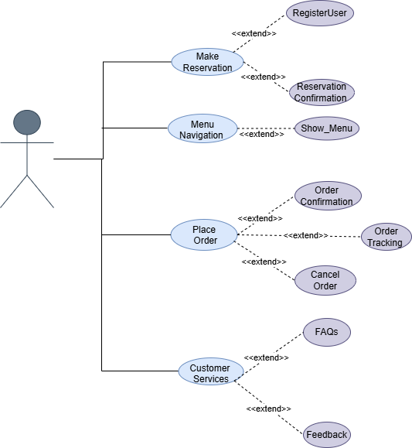
Show the audience you anticipated their questions.
Leave room for Q&A, but use the Appendix as a way to show that you both thought about those questions and have solid answers with supporting information. Let the audience test their understanding of the problem and the solution you’ve outlined - questions give them a chance to talk themselves into your approach, and give you a chance to show mastery of the subject.
Use Case of Restaurant Chatbot

Slide 10
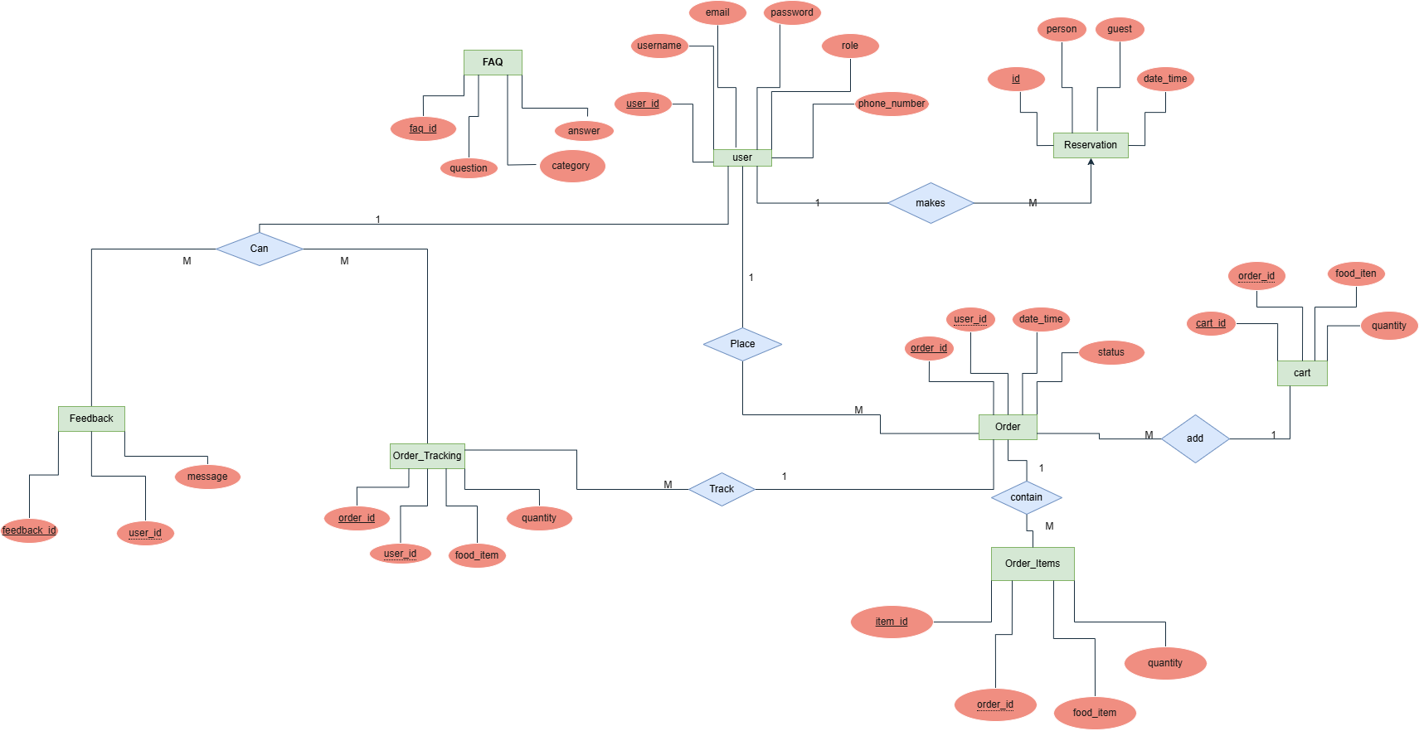
Show the audience you anticipated their questions.
Leave room for Q&A, but use the Appendix as a way to show that you both thought about those questions and have solid answers with supporting information. Let the audience test their understanding of the problem and the solution you’ve outlined - questions give them a chance to talk themselves into your approach, and give you a chance to show mastery of the subject.
ERD

Slide 11
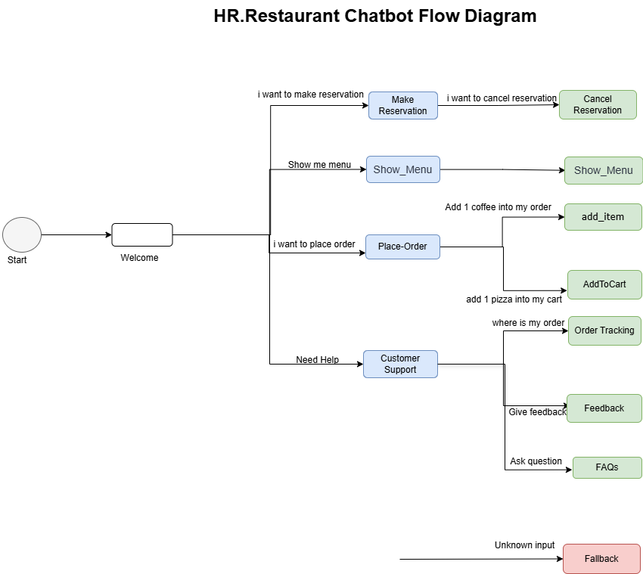

Slide 12
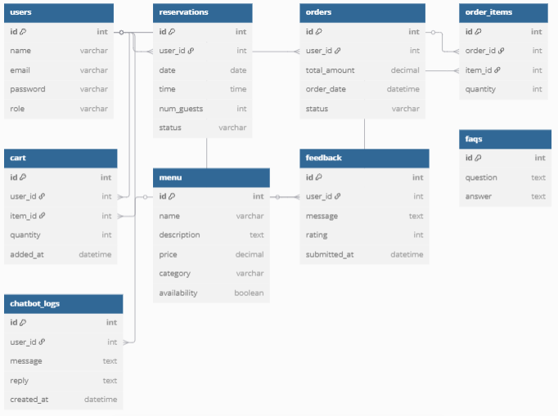
Database Diagram

Slide 13
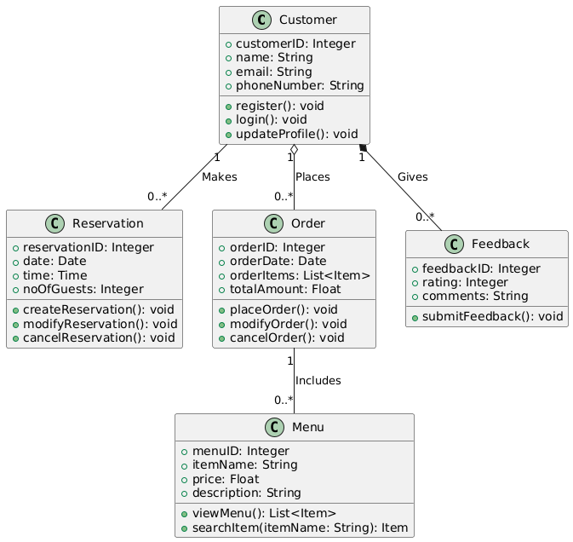
Show the audience you anticipated their questions.
Leave room for Q&A, but use the Appendix as a way to show that you both thought about those questions and have solid answers with supporting information. Let the audience test their understanding of the problem and the solution you’ve outlined - questions give them a chance to talk themselves into your approach, and give you a chance to show mastery of the subject.
Class Diagram

Slide 14
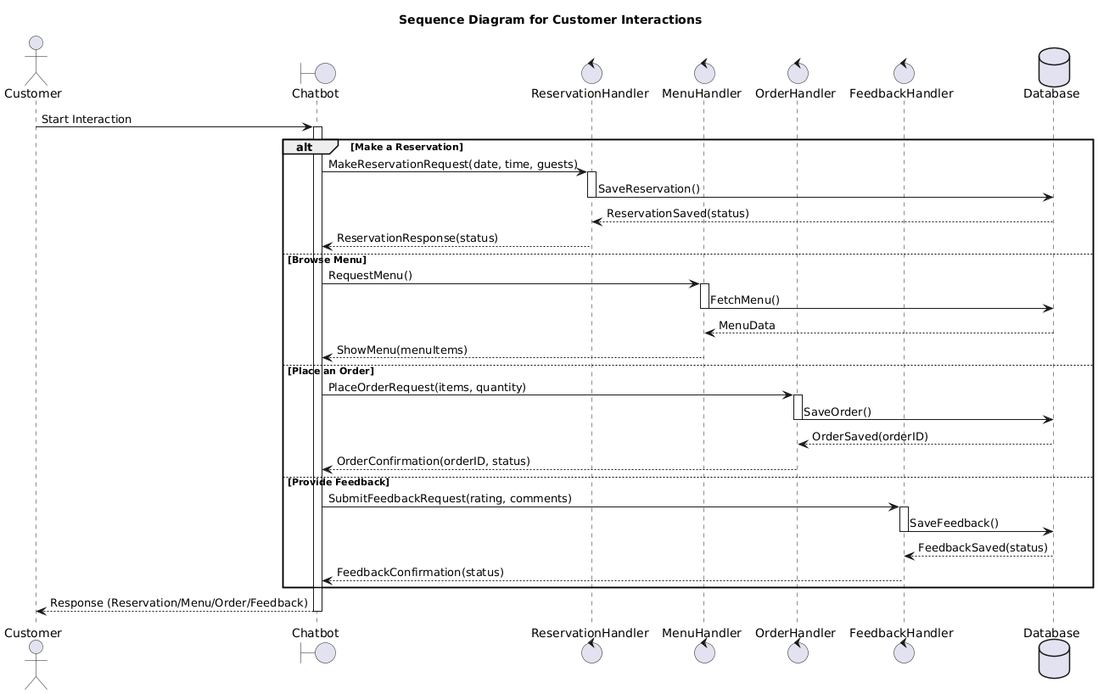
User/customer Sequence Diagram

Slide 15
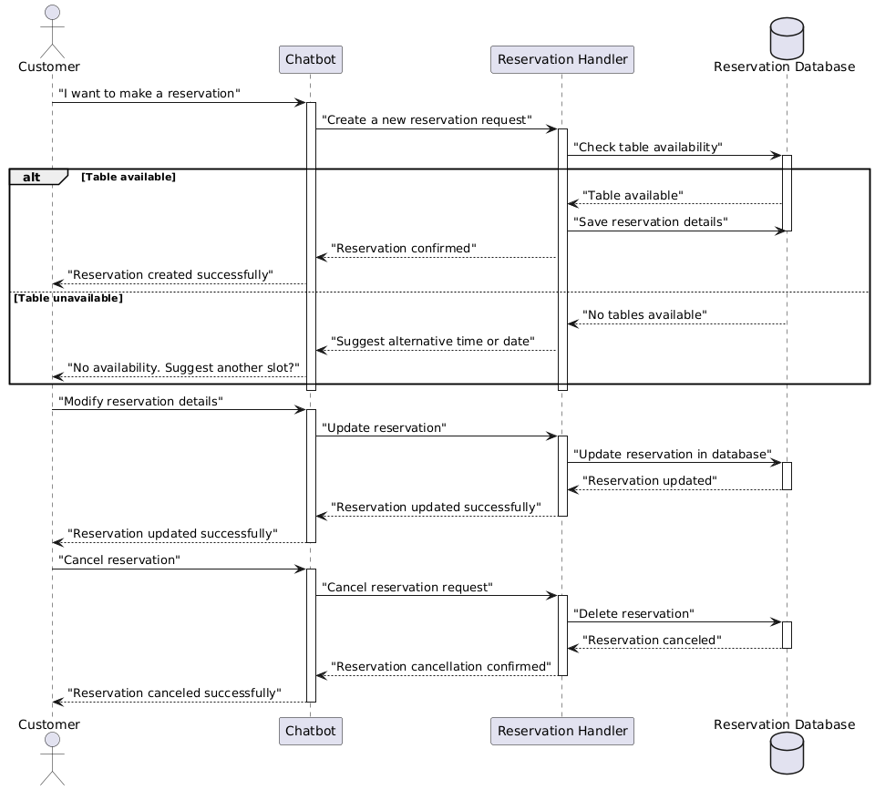
Show the audience you anticipated their questions.
Leave room for Q&A, but use the Appendix as a way to show that you both thought about those questions and have solid answers with supporting information. Let the audience test their understanding of the problem and the solution you’ve outlined - questions give them a chance to talk themselves into your approach, and give you a chance to show mastery of the subject.
Reservation Sequence Diagram

Slide 16
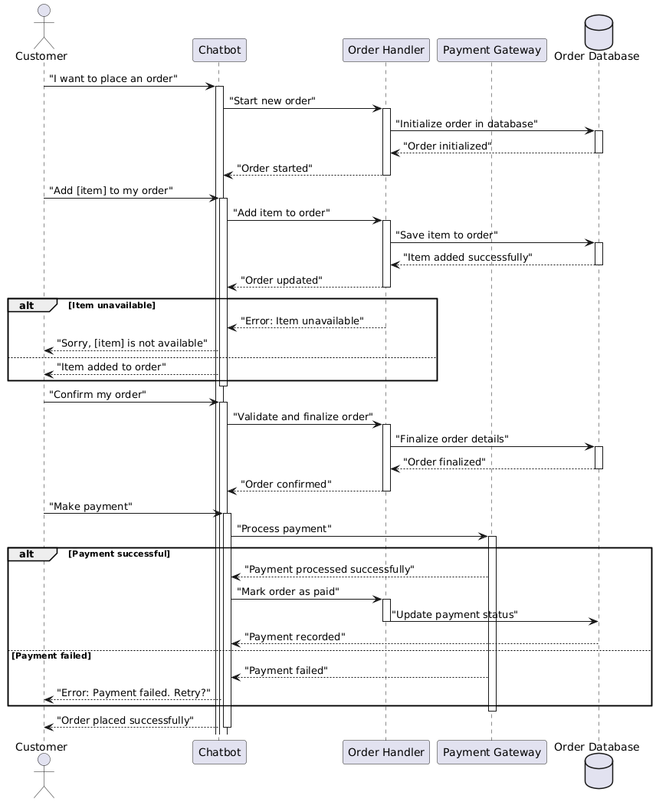
Order Sequence Diagram

Slide 17
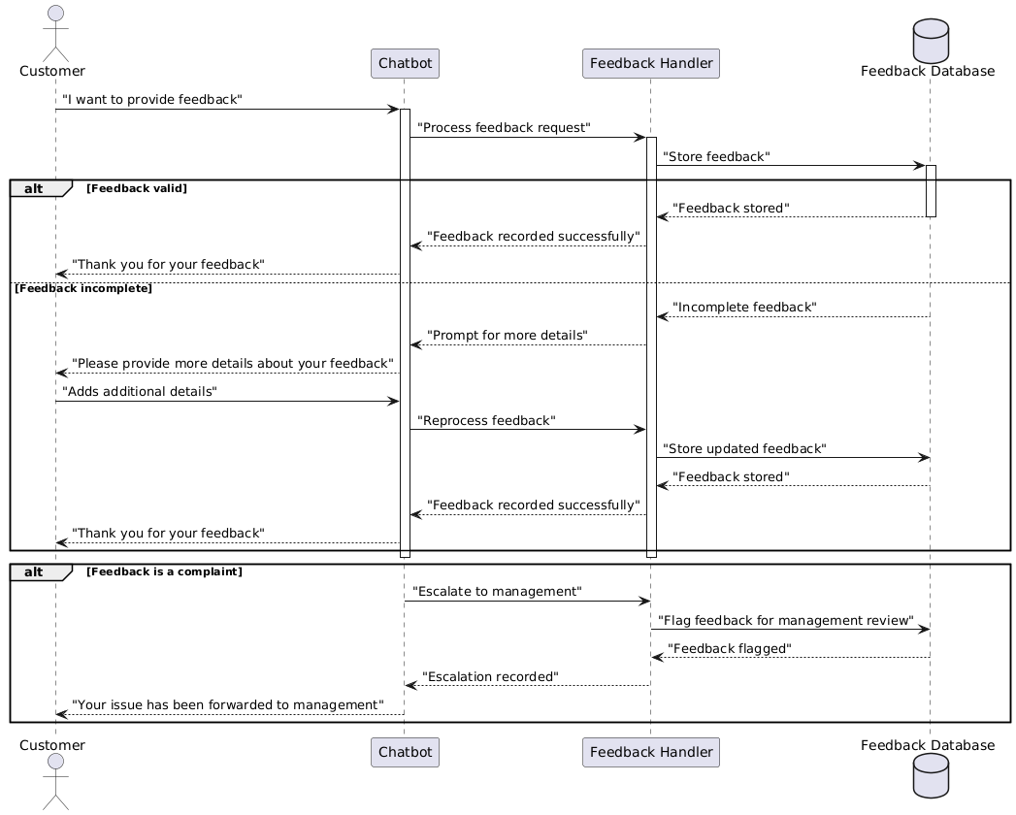
Show the audience you anticipated their questions.
Leave room for Q&A, but use the Appendix as a way to show that you both thought about those questions and have solid answers with supporting information. Let the audience test their understanding of the problem and the solution you’ve outlined - questions give them a chance to talk themselves into your approach, and give you a chance to show mastery of the subject.
Feedback Sequence Diagram

Slide 18
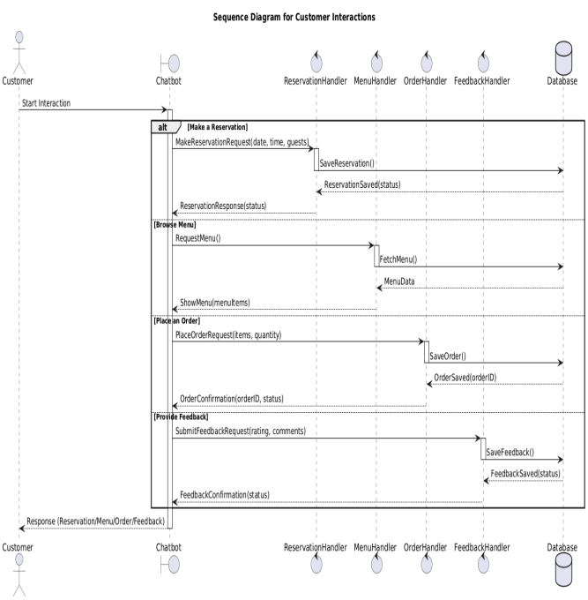
Show the audience you anticipated their questions.
Leave room for Q&A, but use the Appendix as a way to show that you both thought about those questions and have solid answers with supporting information. Let the audience test their understanding of the problem and the solution you’ve outlined - questions give them a chance to talk themselves into your approach, and give you a chance to show mastery of the subject.
Customer Sequence Diagram

Slide 19
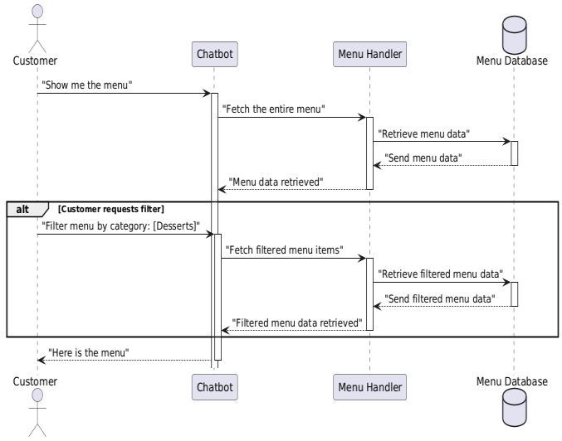
Show the audience you anticipated their questions.
Leave room for Q&A, but use the Appendix as a way to show that you both thought about those questions and have solid answers with supporting information. Let the audience test their understanding of the problem and the solution you’ve outlined - questions give them a chance to talk themselves into your approach, and give you a chance to show mastery of the subject.
Menu Sequence Diagram

Slide 20
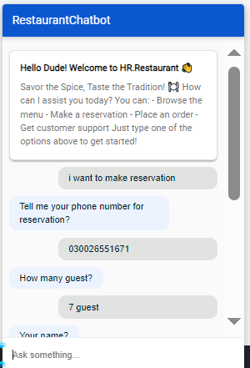
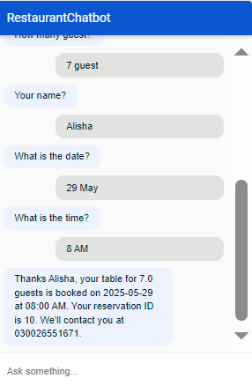
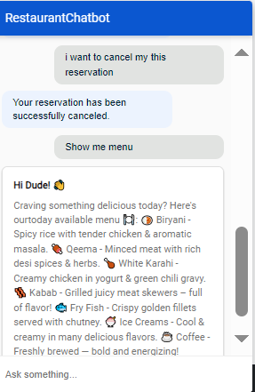
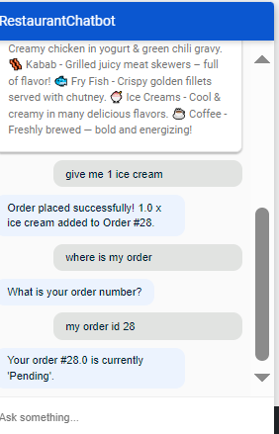
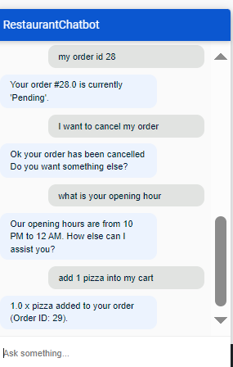
Restaurant Chatbot

Slide 21
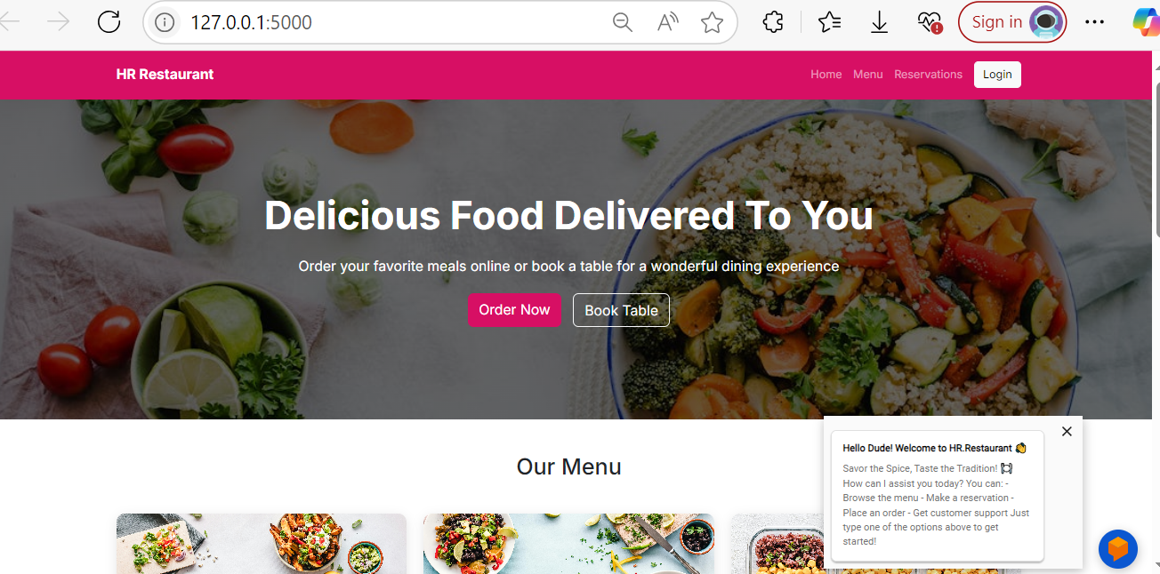
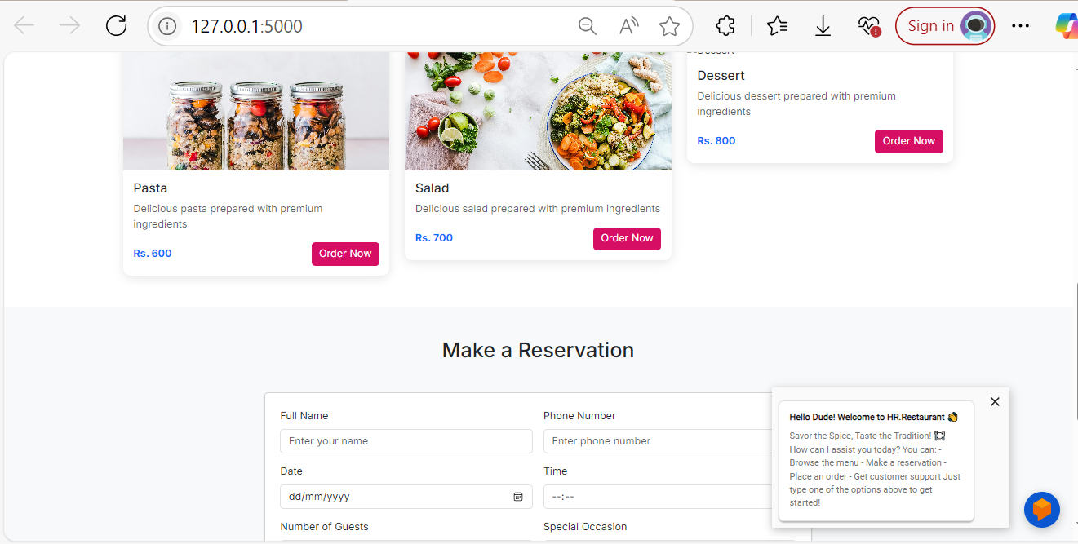
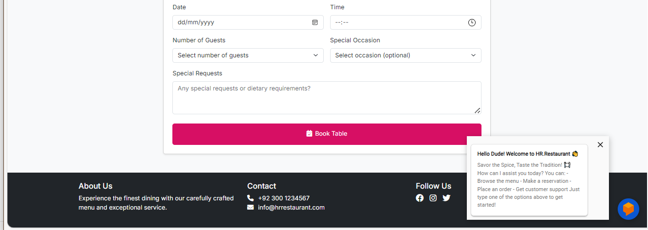
User Interfaces

Slide 22
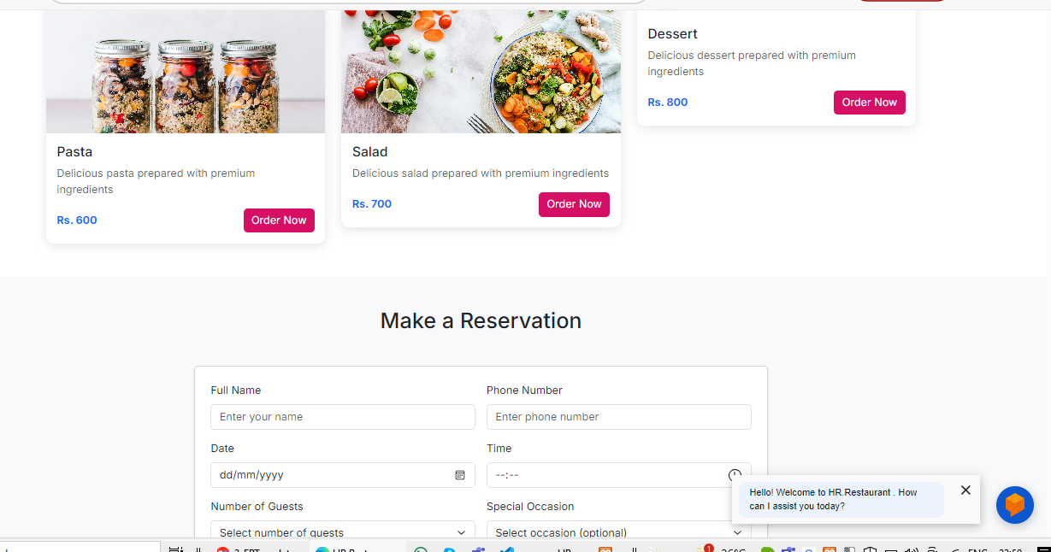
User Interfaces

Slide 23
githublink
https://github.com/hrranger5/HR.Restaurant.git

